Slide 1


WorkflUX: The Workflow User eXperience
An open-source, cloud-ready web application for simplified deployment of CWL workflows
Dr. Mei-Ju (May) Chen, Clarissa Feuerstein-Akgöz, and
Dr. Pavlo Lutsik
The Division of Cancer Epigenomics
German Cancer Research Center
Main developer: Kersten Breuer

Slide 2









Principle Roles in Workflow Development and Deployment
GATCTA
data
wet-lab researcher
results
workflow
workflow / method developer
HPC infrastructure
HPC
engineer

Slide 3
Principle Roles in Workflow Development and Deployment
GATCTA
graphical framework
data
WorkflUX
wet-lab researcher
results
workflow
workflow / method developer
HPC infrastructure
HPC
engineer

Slide 4
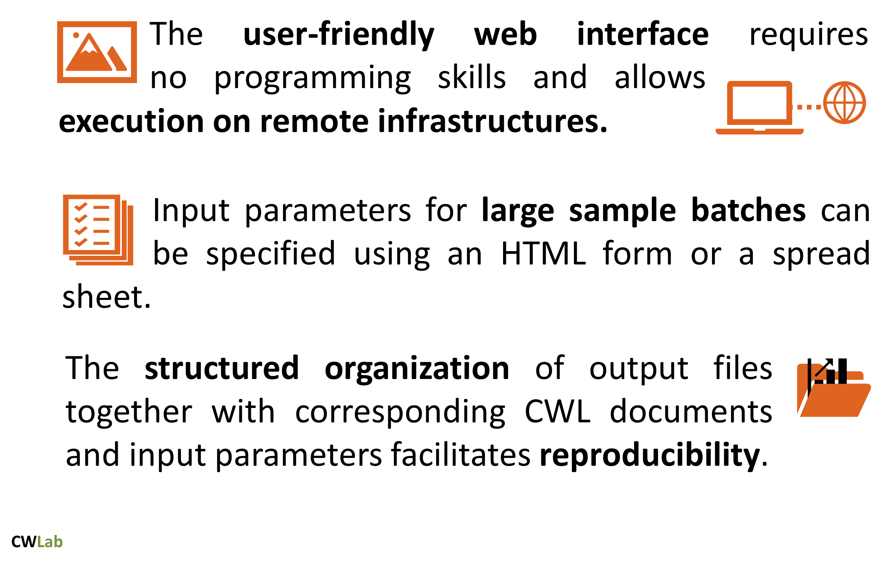
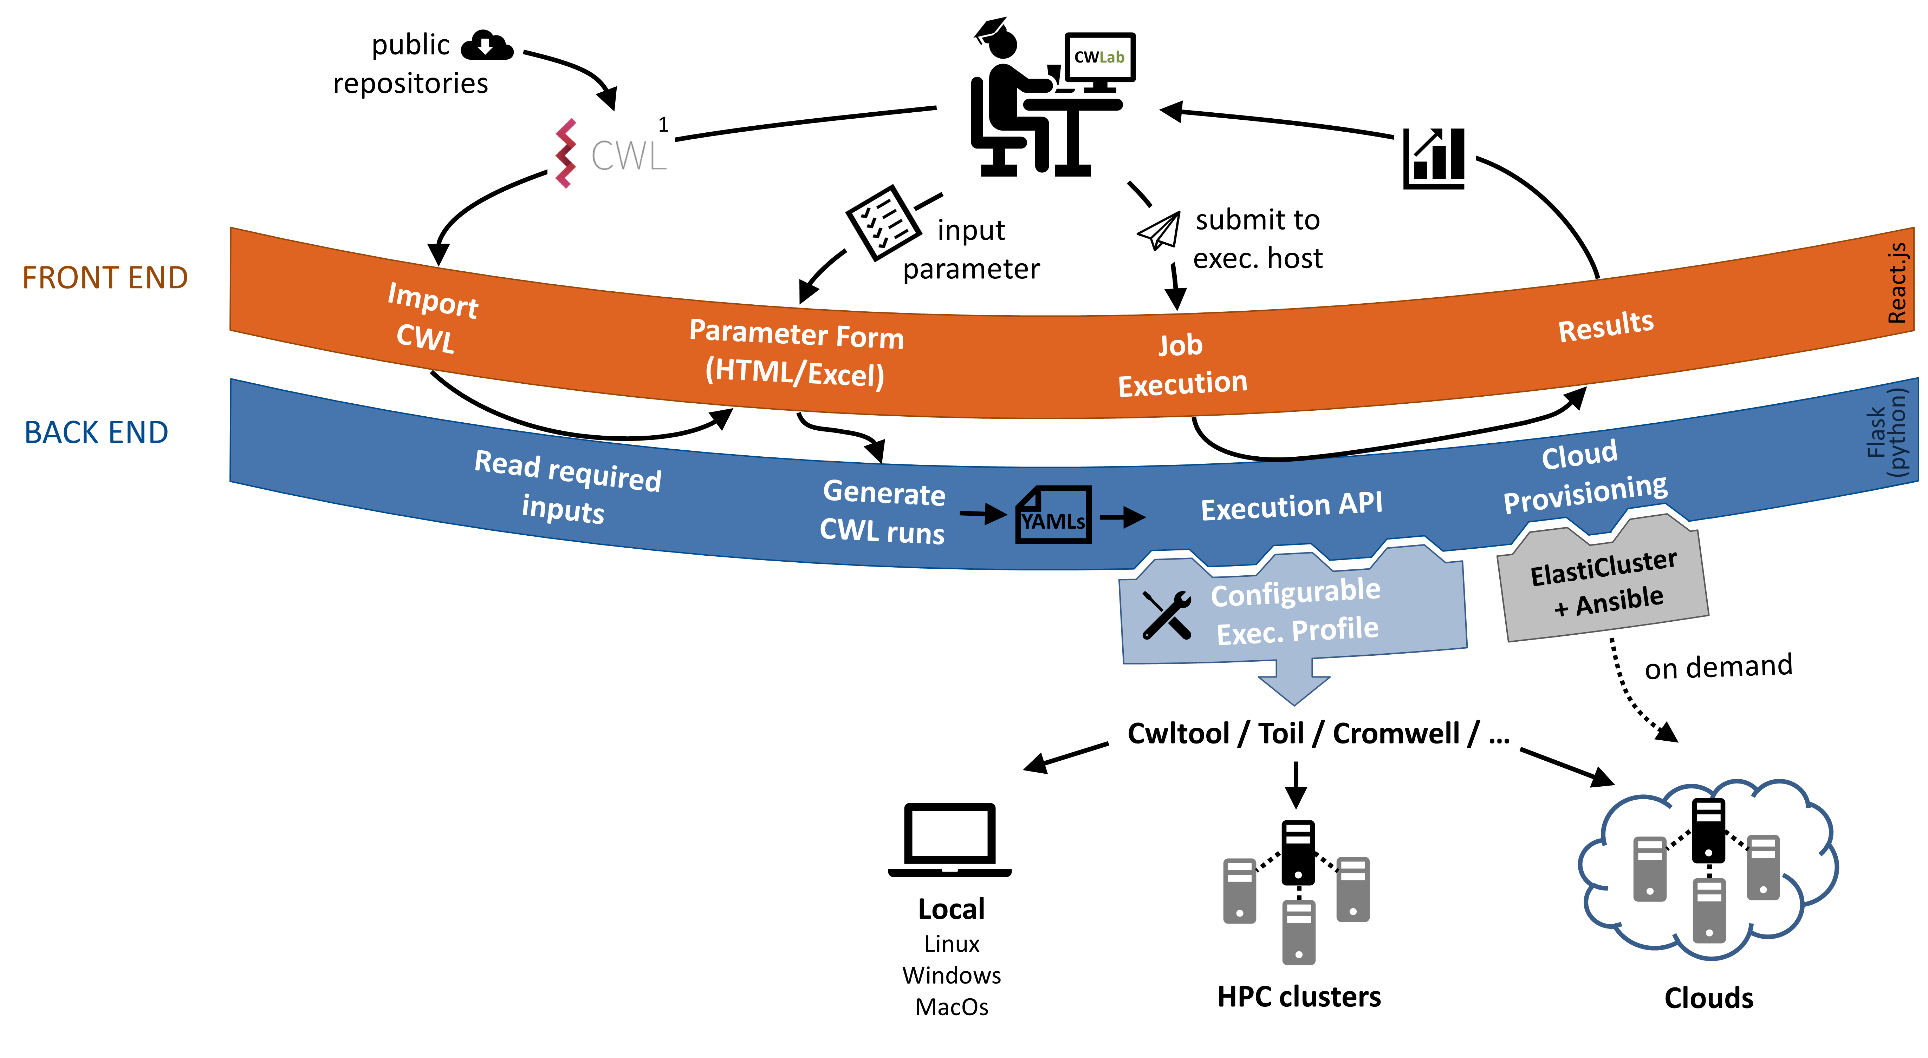
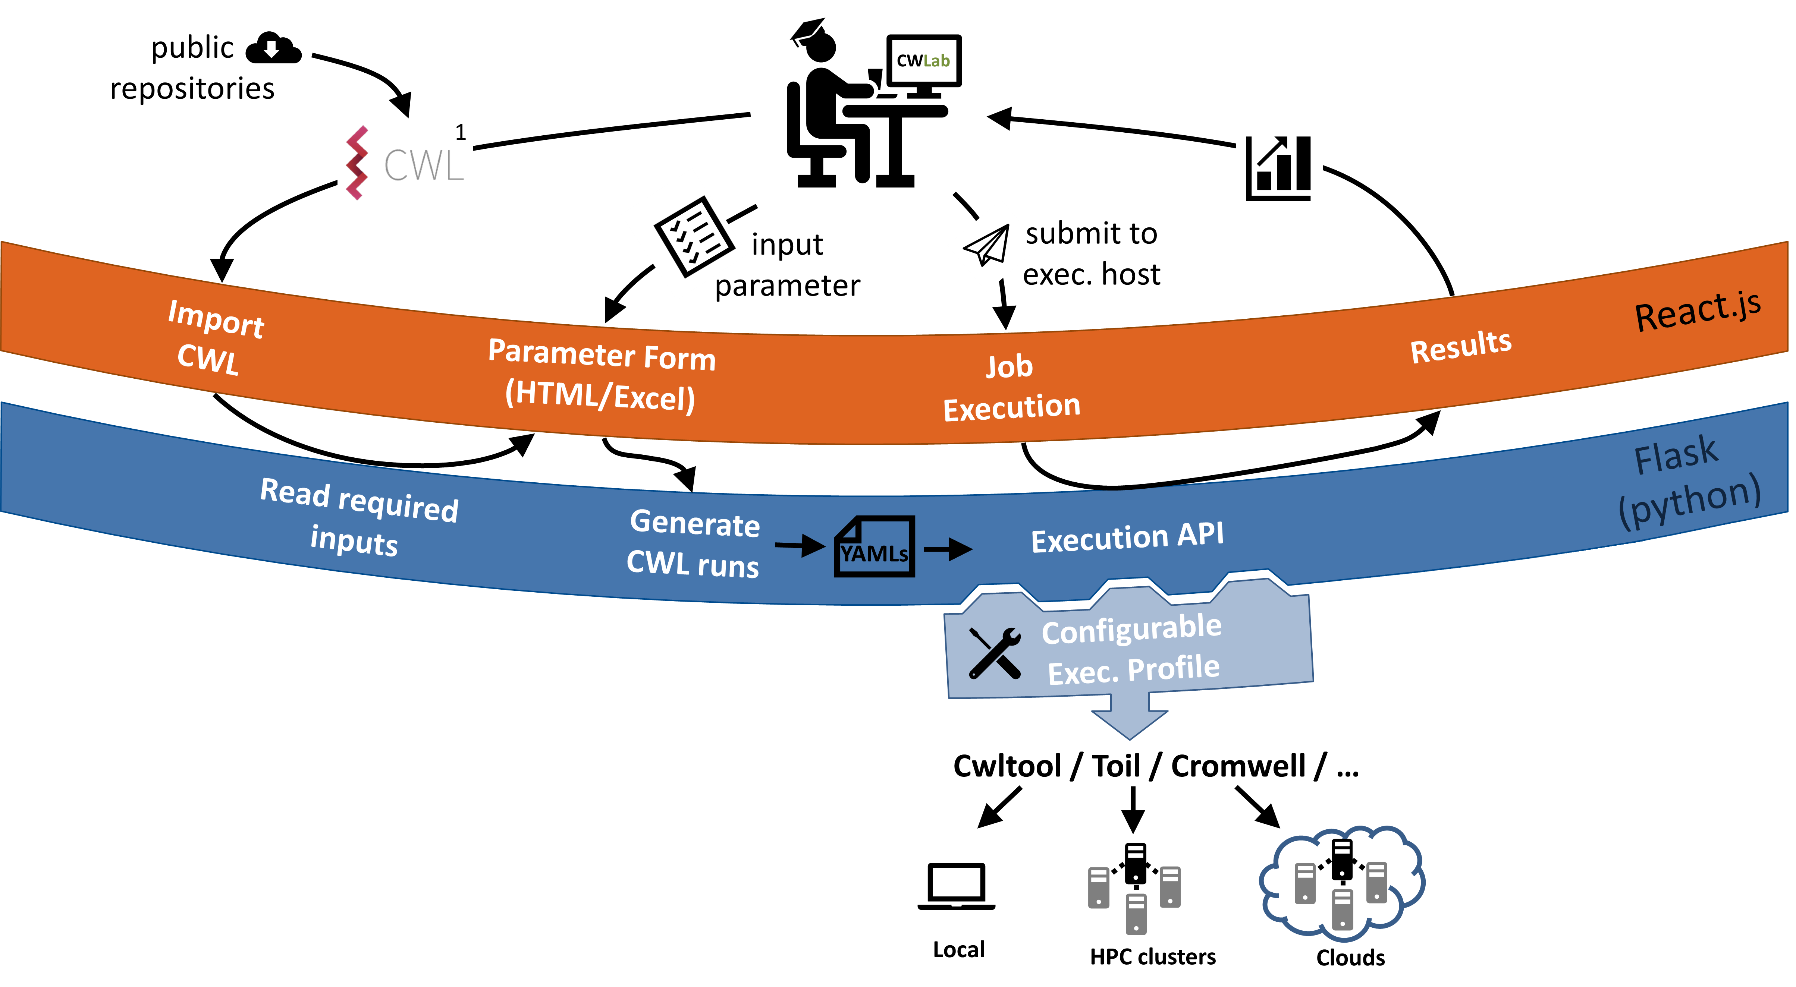


WorkflUX – An Outline
Highly customizable execution API,
integrable with almost any CWL runner
light-weight, easy to setup and adapt

Slide 5


WorkflUX – Technical Detail
Front End
single page web app
SQLite
MySQL
etc.
AJAX
Organization of:
users
workflows
jobs
Back End
python-based,
scalable with Gunicorn
Exec. Profile:
python / bash / powershell
1. prepare:
infrastructure provisioning,
file upload,
setup execution environment
2. execute:
workflow + input → execution engine
3. evaluate:
evaluate success of job
4. finalize:
cleanup,
file download

Slide 6
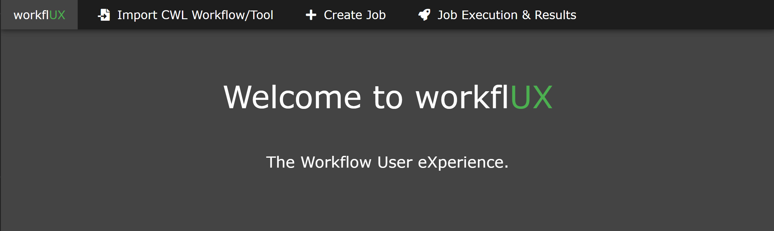
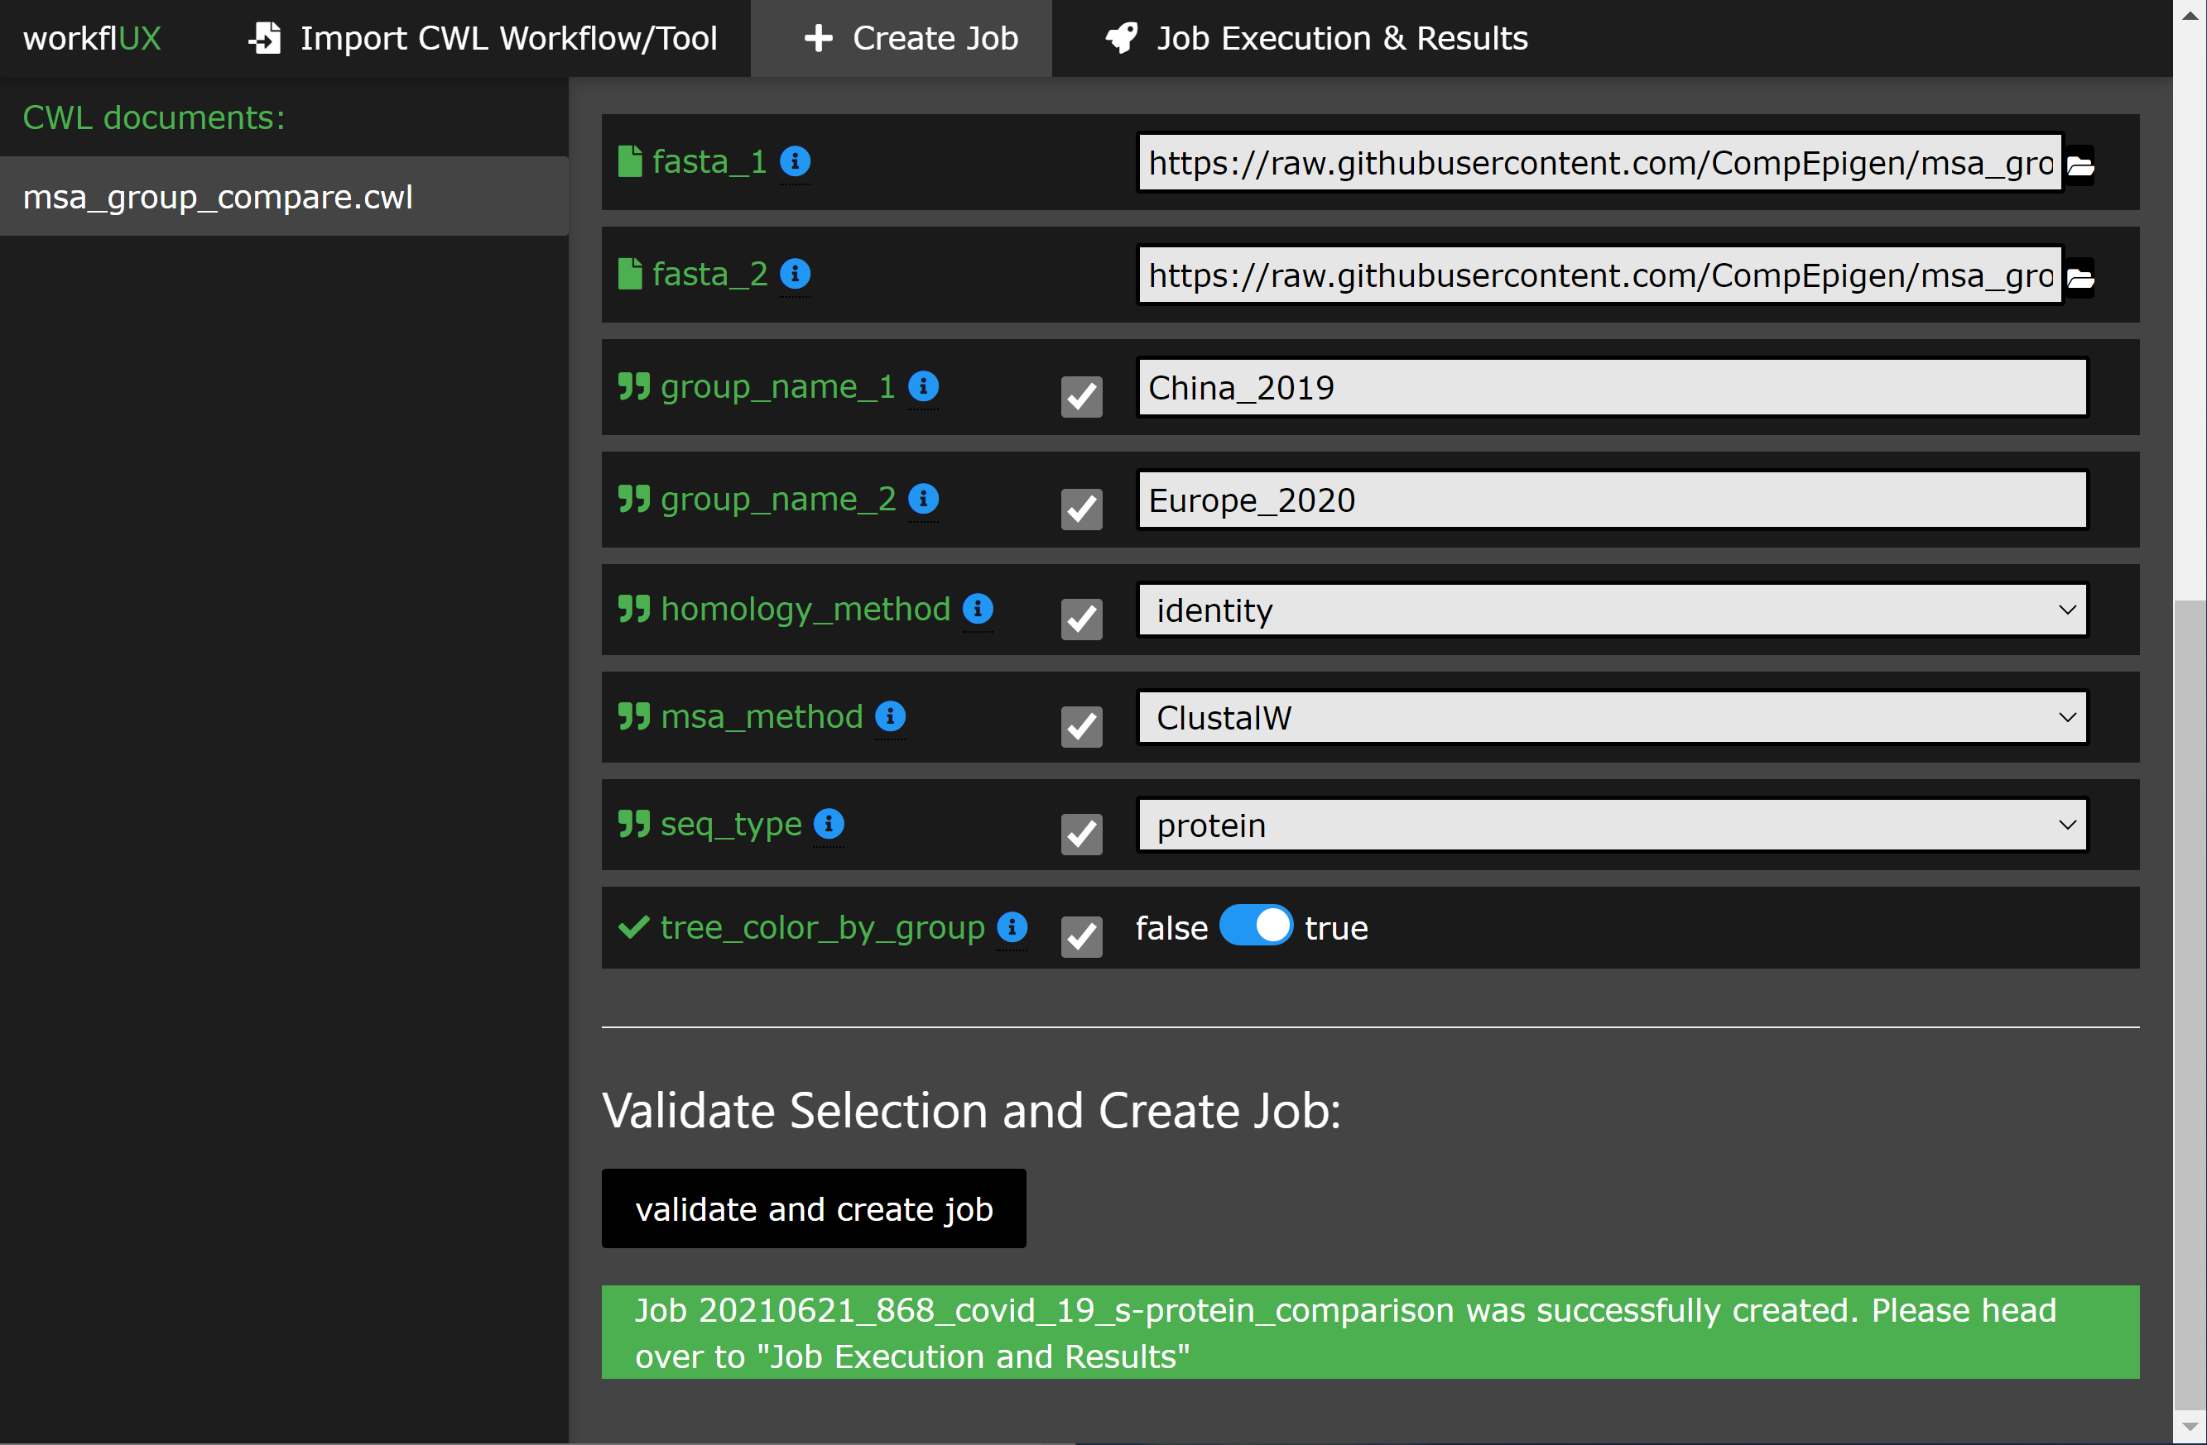
How does it look?

Slide 7
Target Audience and Usage Scenarios
Interdisciplinary Research Groups:
used locally as desktop application (Linux, Windows, MacOs)
HPC in protected networks:
Servers
Clusters
Clouds
currently
minimal setup required
integration of GA4GH WES standard
Organizational Scale:
multi-user, multi-project management
in development
execution on publicly available infrastructure
collaborative work on protected data
Notes:
https://www.ga4gh.org/news/ga4gh-wes-api-enables-portable-genomic-analysis/

Slide 8








Participating in the Elixir Cloud and AAI Project
data
WorkflUX
public webserver
results
Elixir User
User Authentication
WES
Worflow Execution Service (WES)
Task Execution Service (TES)
(TES on Kubernetes)
Kubernetes Workers
https://elixir-europe.github.io/cloud/

Slide 9

Please try it out
https://github.com/CompEpigen/WorkflUX
Open source - Apache 2.0 License
Easy to install: python3 -m pip install workflux
Feedback and contribution is welcome.

Slide 10





Thanks to our Contributors
Kersten Breuer
Yoann Pageaud
Yassen Assenov
Reka Toth
Christoph Plass
Pavlo Lutsik
Mei-Ju May Chen
Clarissa Feuerstein-Akgöz
Kersten Breuer
Christian Lawarenz
Sven Twardziok
Marius Diekmann
The entire Elixir Cloud and AAI Team for their current and future work.

